Slide 1

Mechanisms
The Bionic Tigers - 10464

Slide 2
Game Process
First Transformation:
Obtain Element
Second Transformation: Transfer Element
Third Transformation:
Score Element

Slide 3
Obtaining Elements
Historically common FTC element obtaining methods
Element Types
Grabbers
Overhead Spinning
Dual Side Spinning
Passive

Slide 4
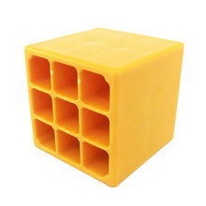
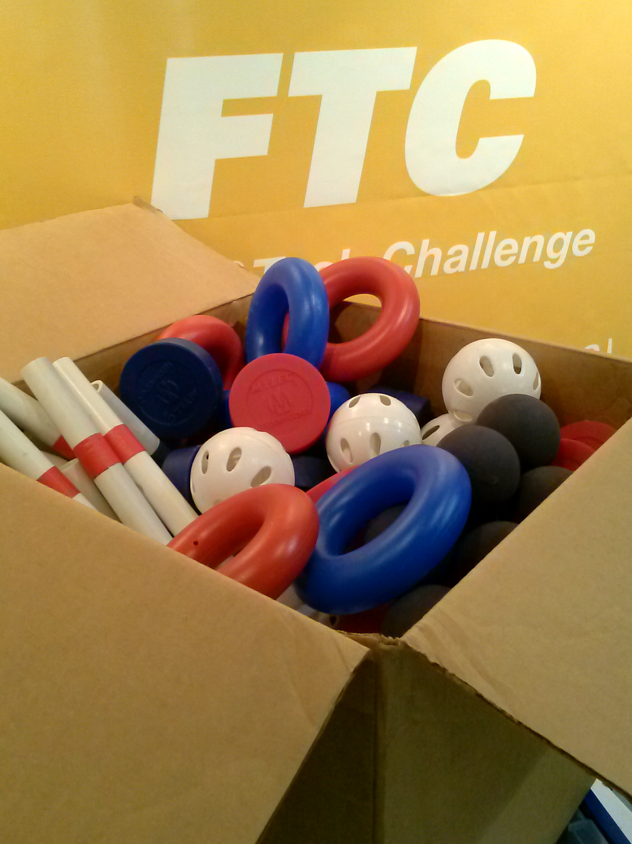
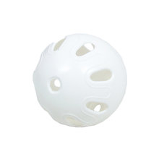
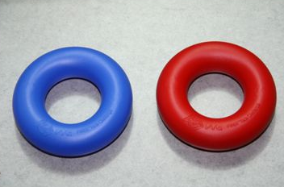
Element Types
Sphere
Cube
Unorthodox

Slide 5
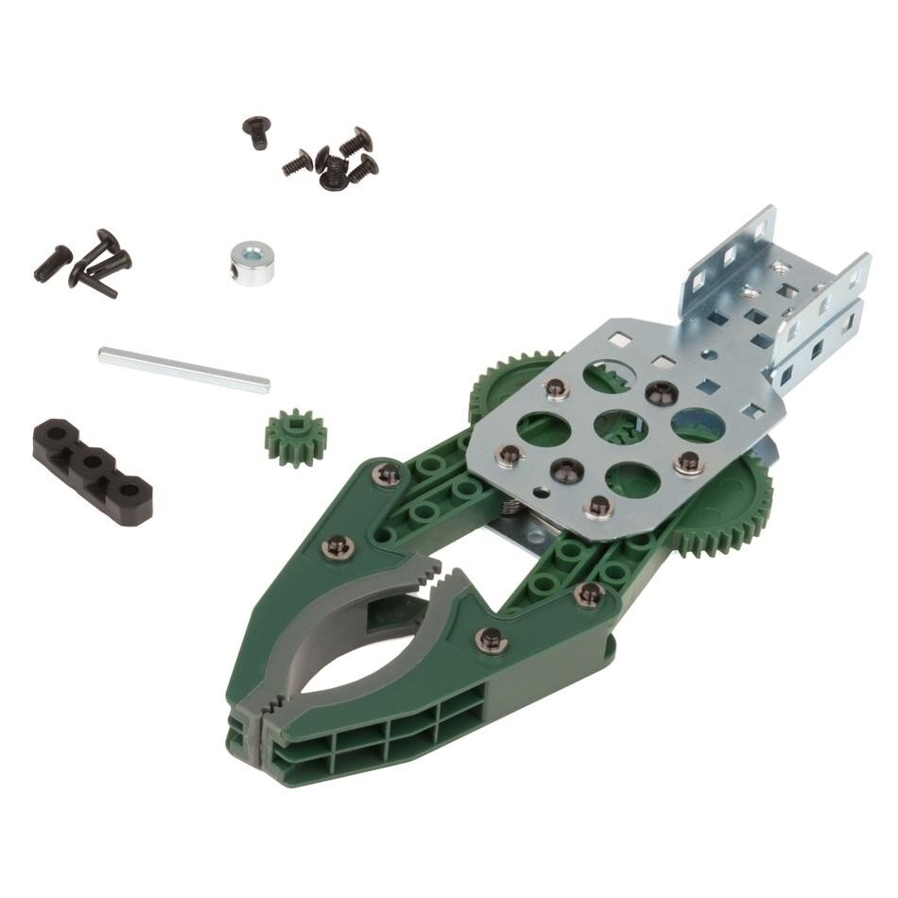
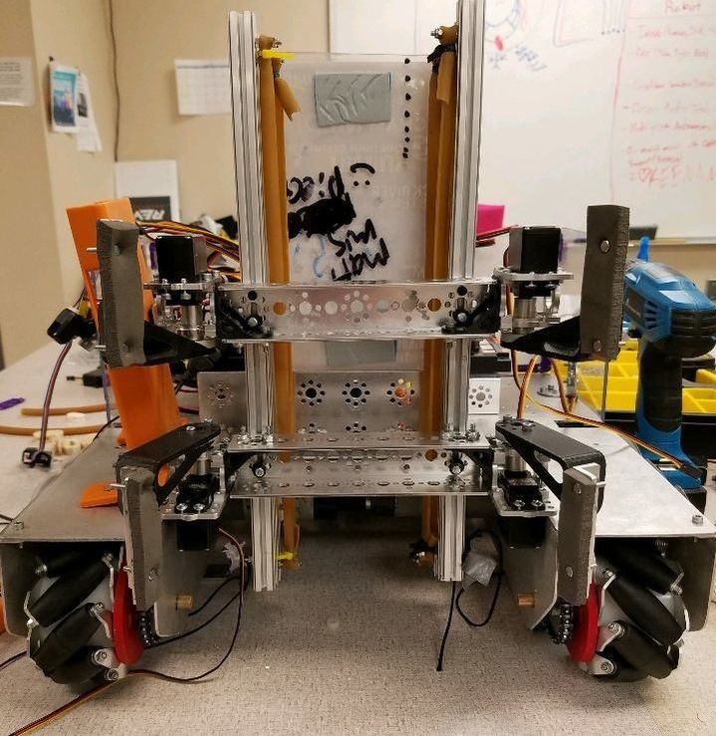
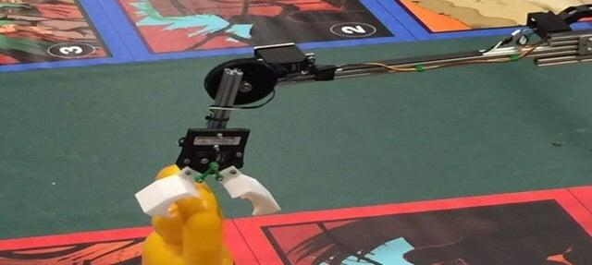
Grabbers
Limited range of motion
Versatile for element shape
Time consuming collection process
Limited number of elements controlled
Requires precise lineup

Slide 6
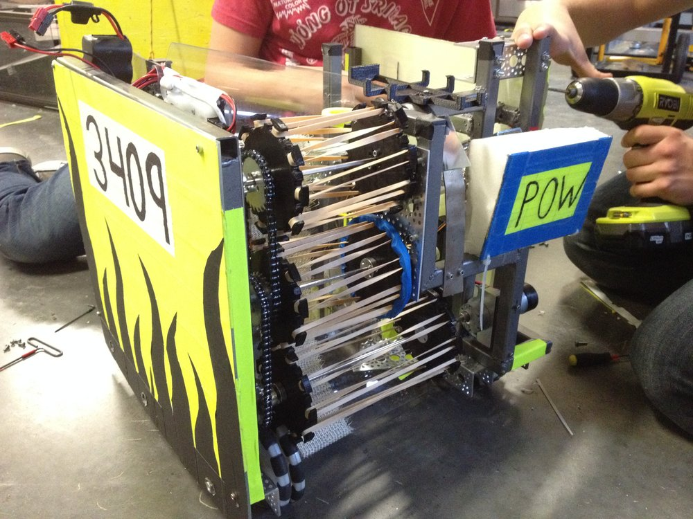
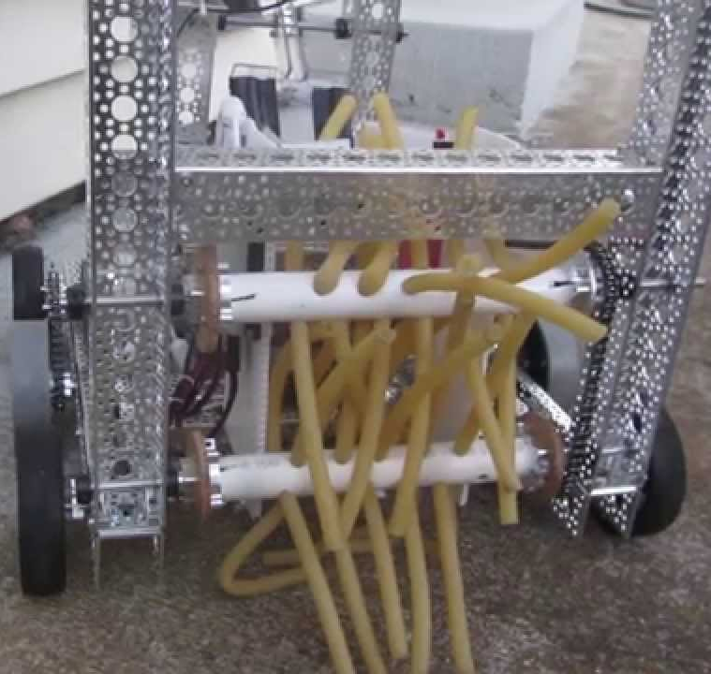
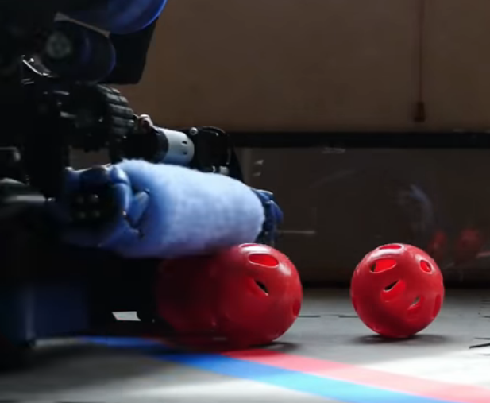
Overhead Spinning
Fast collection
Minimal lineup required
Reliable for cubes and spheres
Space consuming

Slide 7
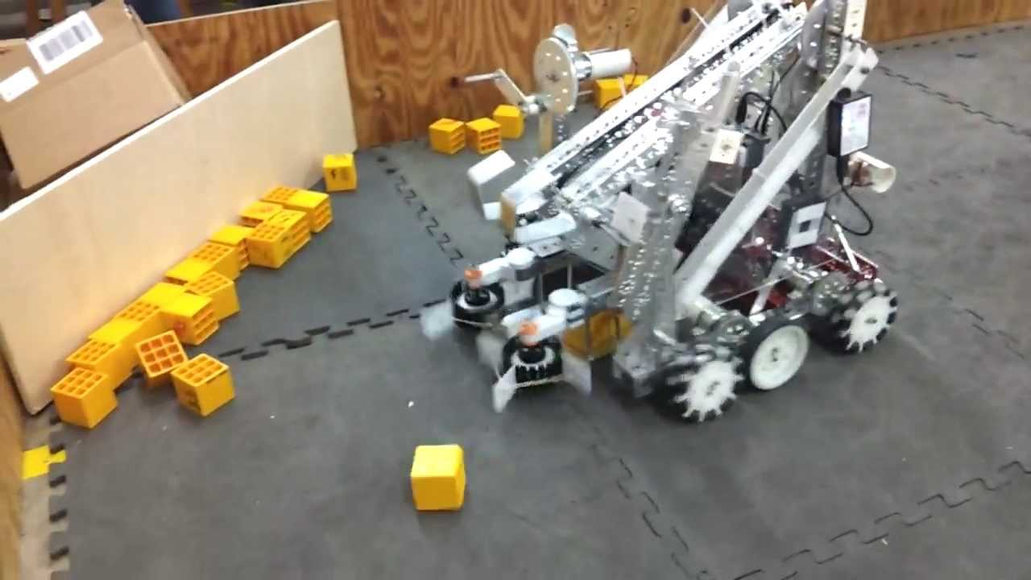
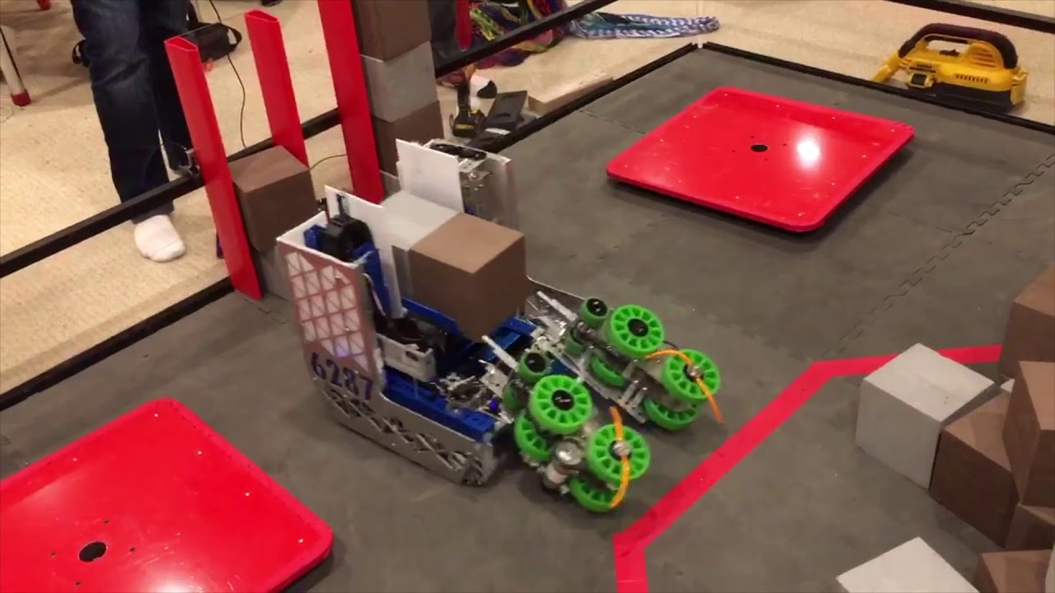
Dual Side Spinning
Useful for unorthodox shapes and cubes
Fast
Reliable
Requires some lineup
Not very versatile

Slide 8
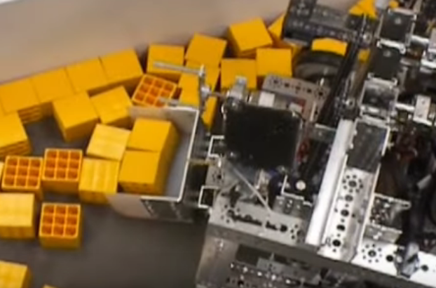
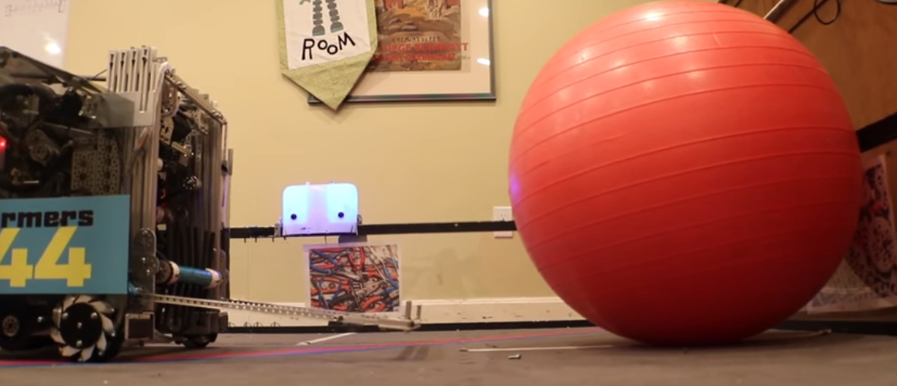
Passive
Scoops
Forks
Cups
Simple
Requires lineup
Not very versatile

Slide 9
Transfering Elements
Single Bar
Chain Bar
4 Bar Linkage
Linear Slides
Moving from obtaining position to scoring position

Slide 10

The Unspoken Truth
Lifting Things

Slide 11
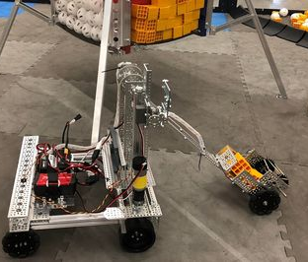
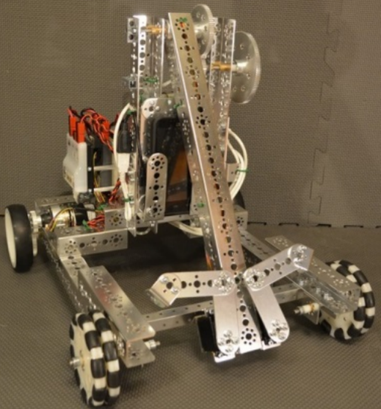
Single Bar
Simple
Changes Orientation
Limited Reach

Slide 12
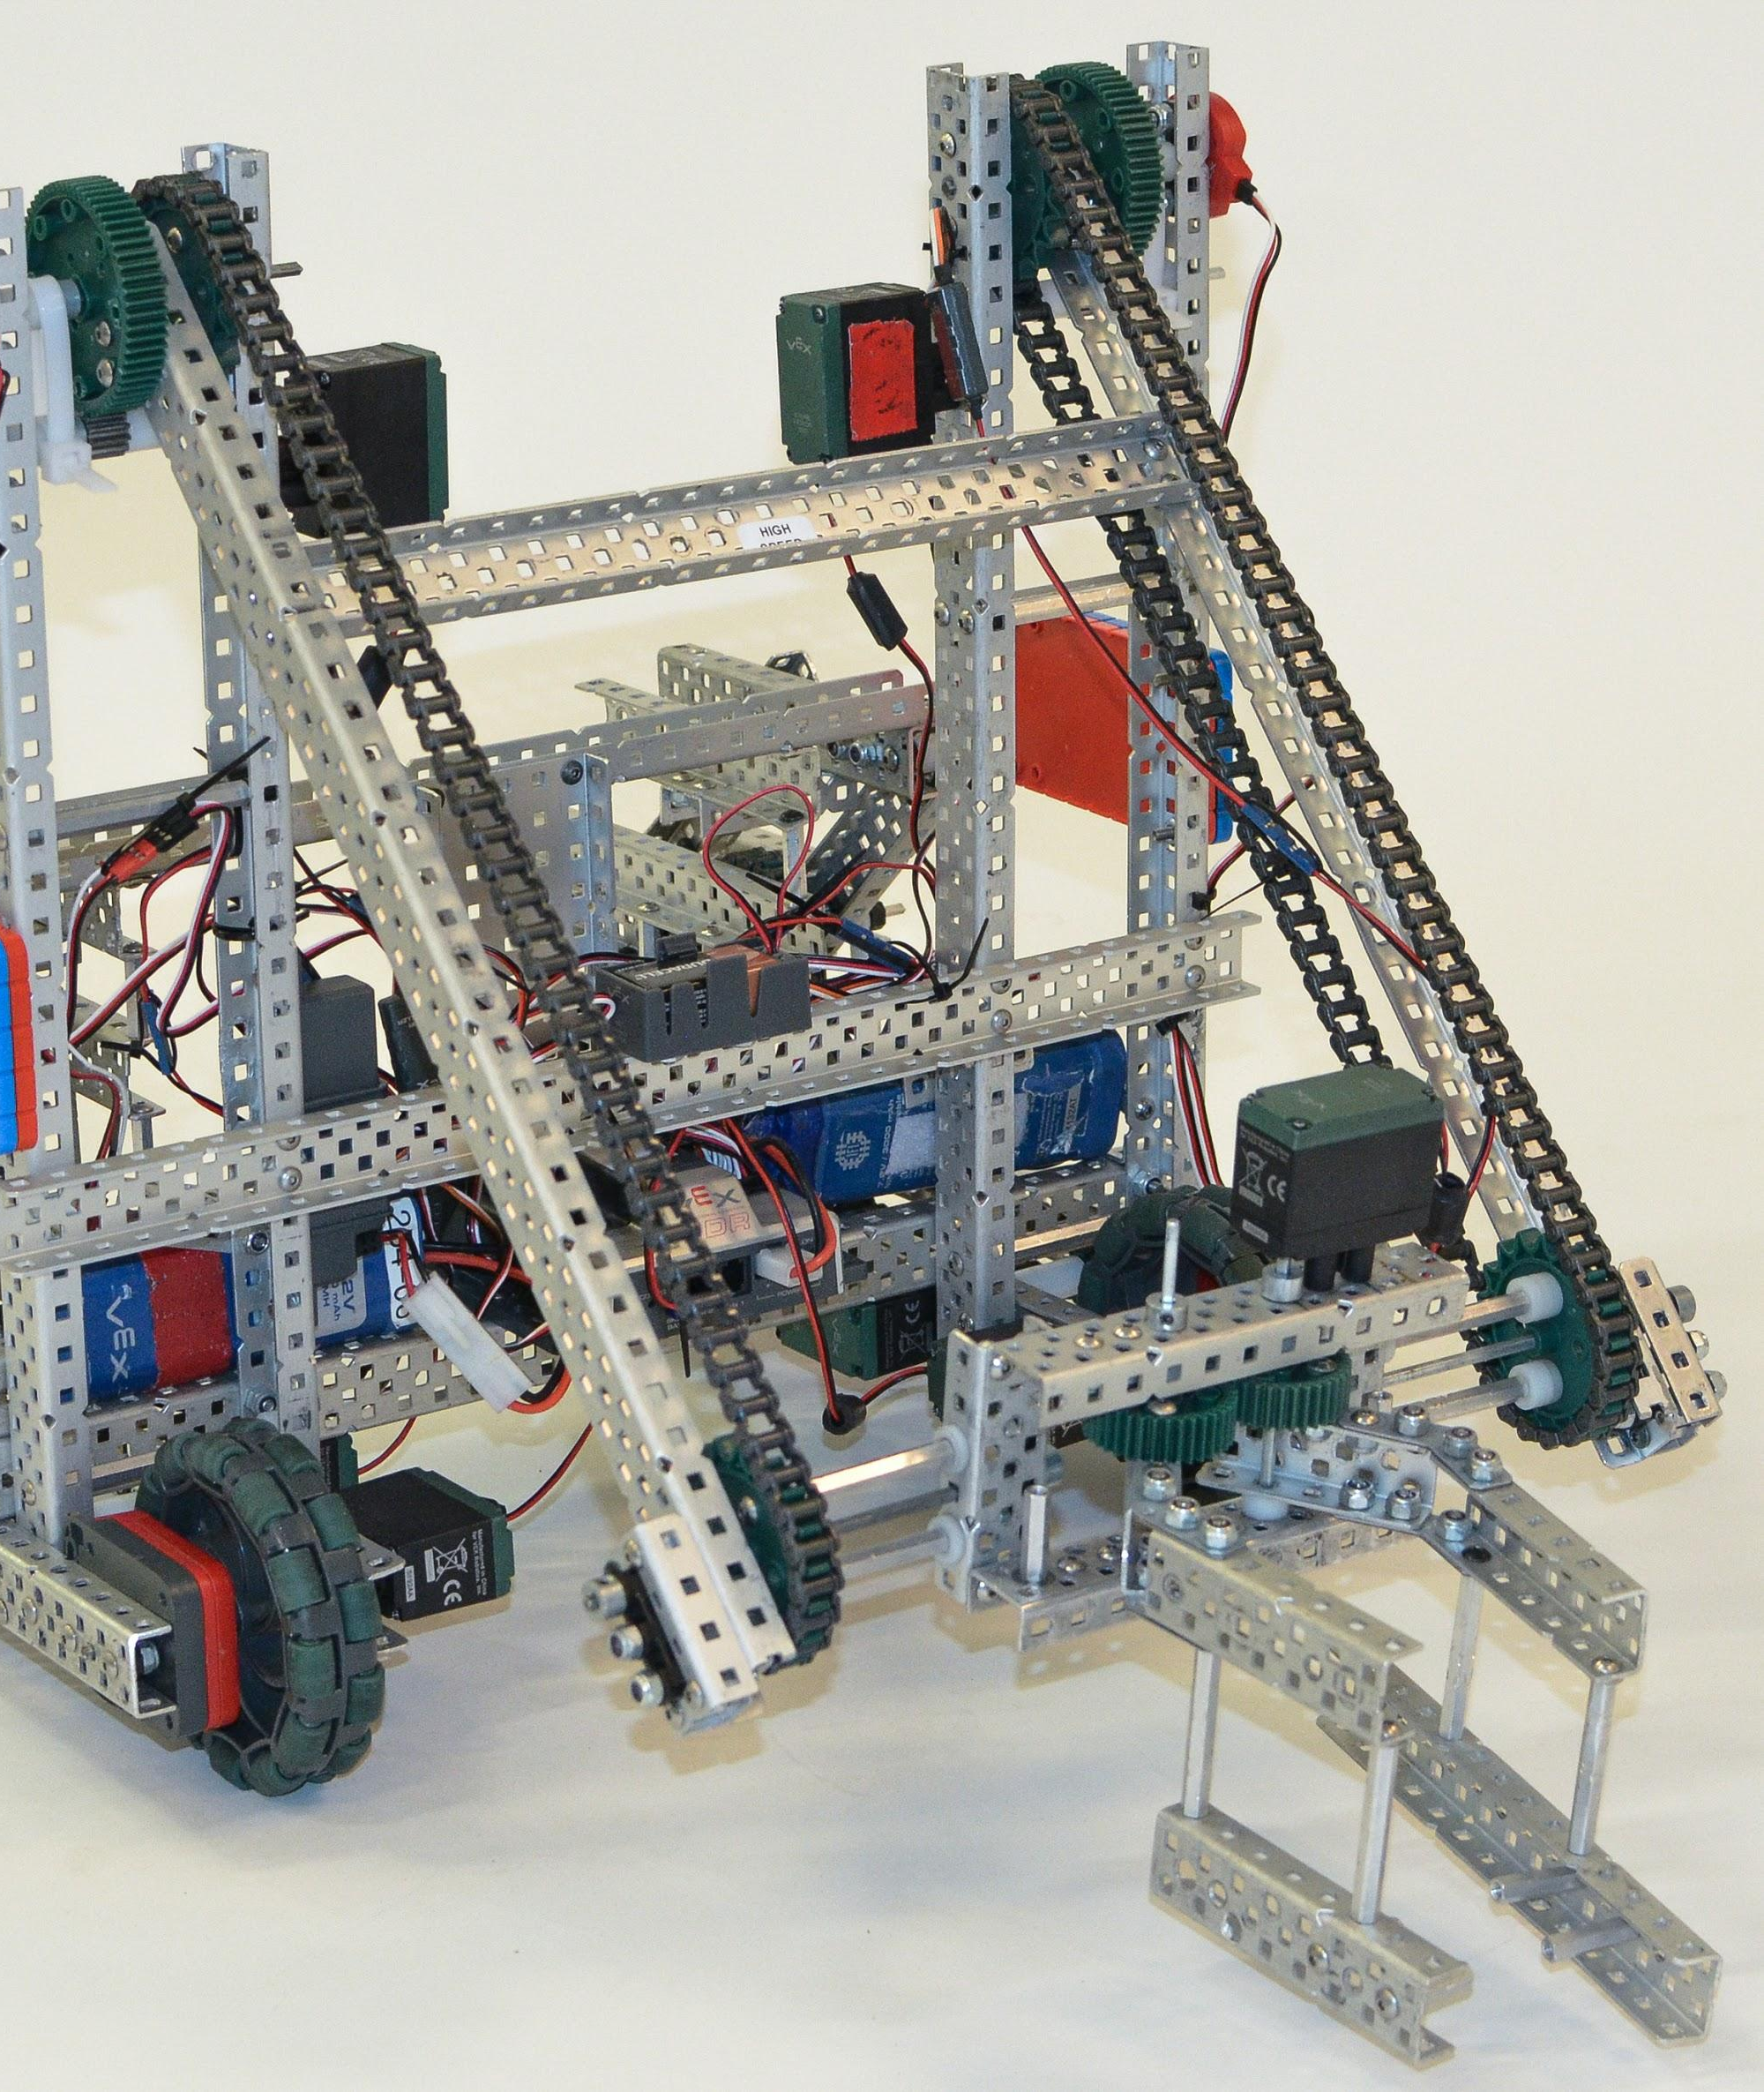
Chain Bar
Simple
Maintains Orientation
Limited reach

Slide 13
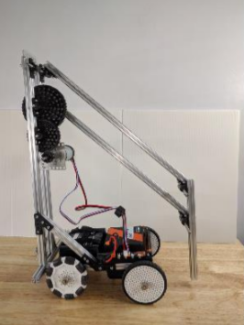
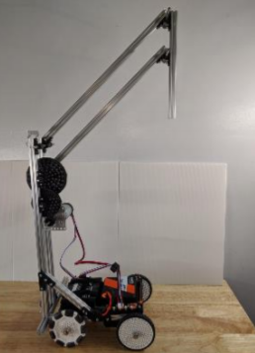
4 Bar Linkages
Semi-complex
Maintains Orientation
Limited Range
Opportunities for complexity
6 Bar
Double Reverse 4 Bar

Slide 14
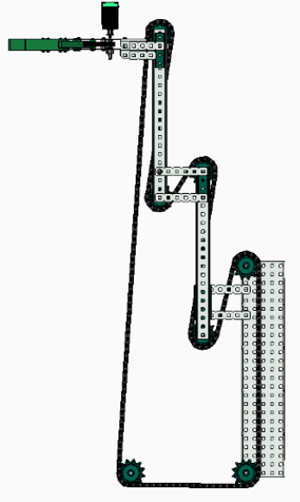
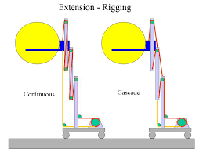
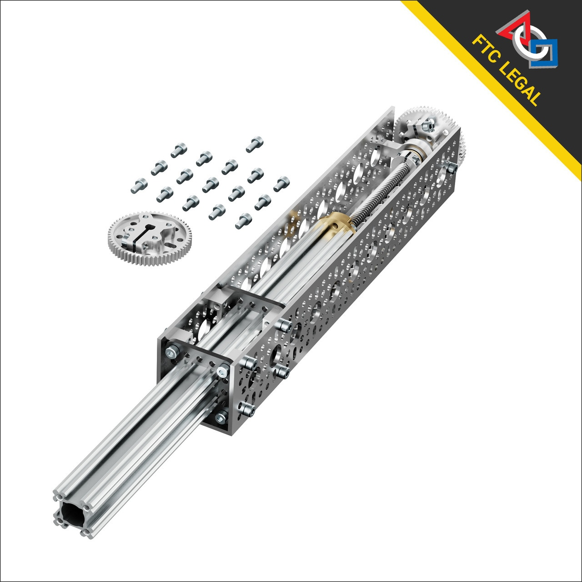
Linear Slides
Semi-complex
Single Direction extension
Multi-stage increases range
Extremely common in FTC
Strings (Cascade and Snake)
Belts/Chain
Lead Screws

Slide 15
Scoring Zone Type
Tips and Tricks
Scoring Elements
How to get the points

Slide 16
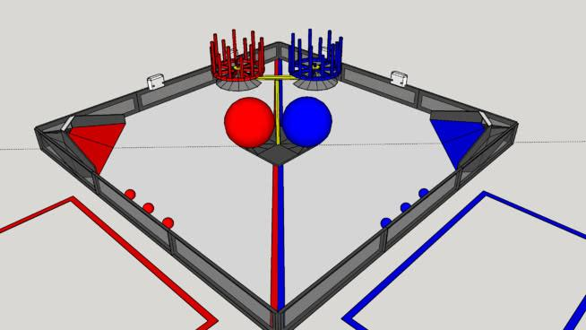
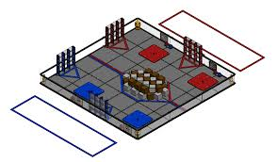
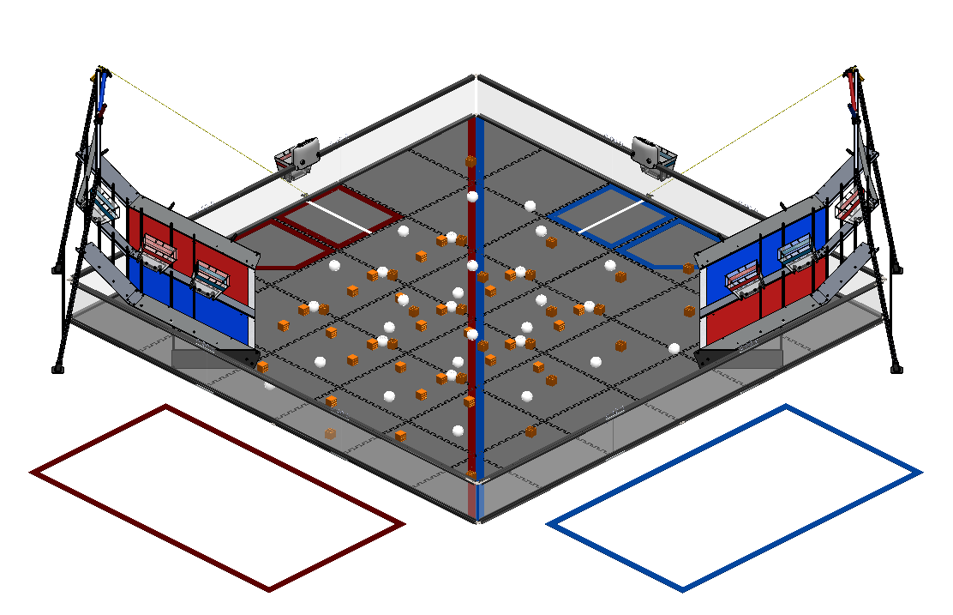
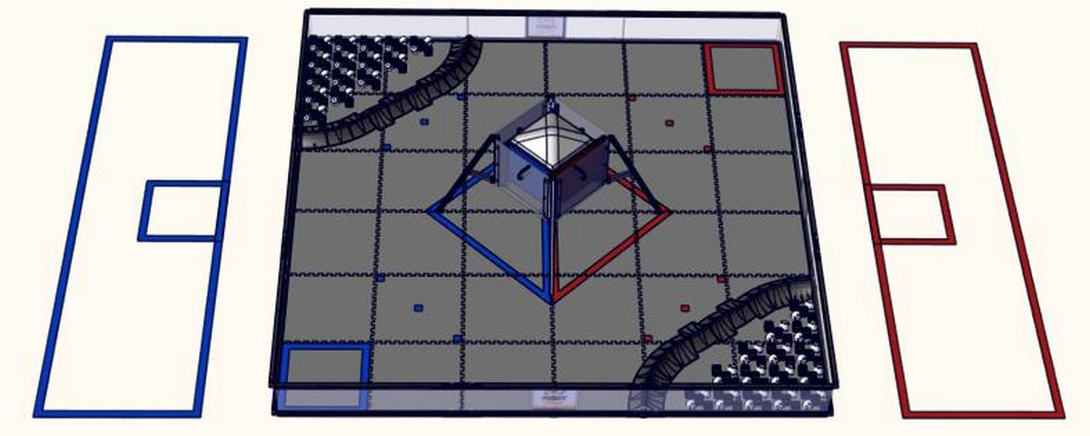
Scoring Zone Type
Launching
Dropping
Pushing
Balancing
Lifting

Slide 17
Tips and Tricks for Scoring Elements
Keep It Simple
Focus On Reliability
Is It Easy For The Drivers?
Research Past Games
Look At Other Teams

Slide 18

Credits
This lesson was written by The Bionic Tigers 10464 for FTCTutorials.com
You can contact the author at
More lessons for FIRST Tech Challenge are available at www.FTCtutorials.com
Website:
http://lovelandrobotics.com/team10464
Twitter:
@BionicTigersFTC
Email:
BionicTigers10464@gmail.com
This work is licensed under a
Creative Commons Attribution-NonCommercial-ShareAlike 4.0 International License.
Copyright 2020 FTCTutorials.com (Last edit 4/1/2020)

